Slide 1
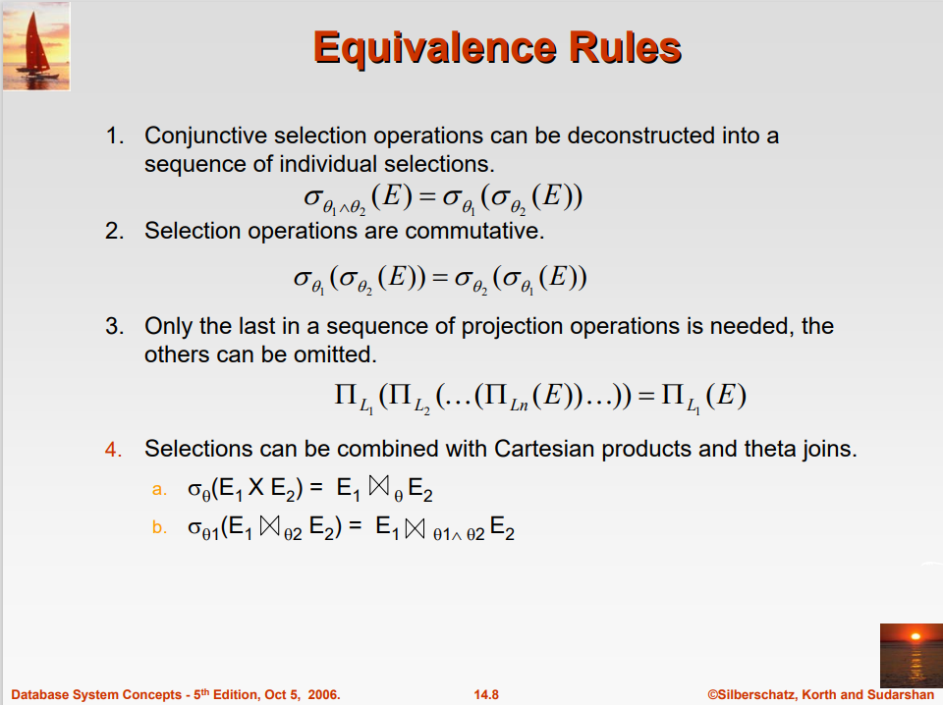
Slide 15- <number>

Slide 2
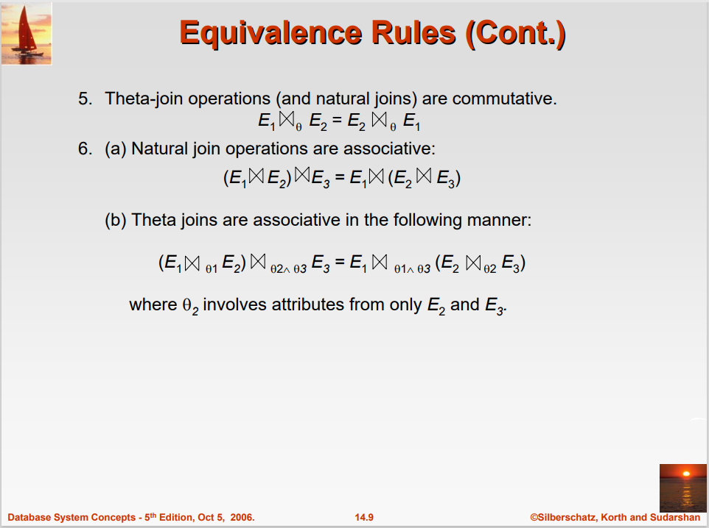
Slide 15- <number>

Slide 3
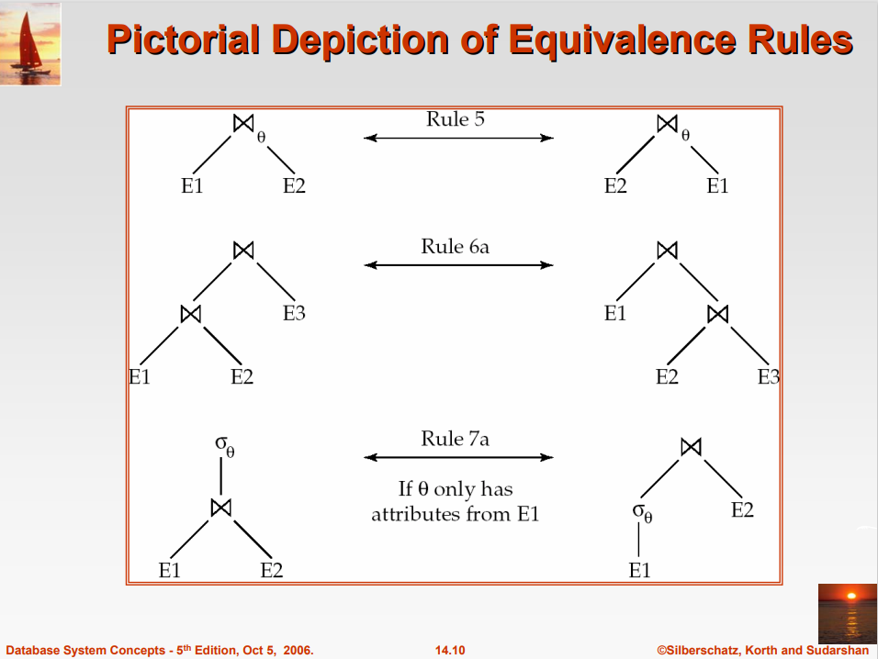
Slide 15- <number>

Slide 4
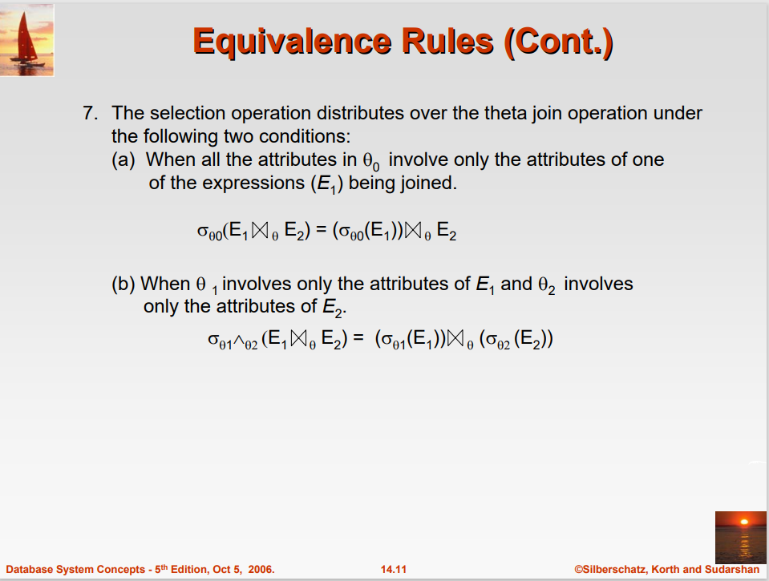
Slide 15- <number>

Slide 5
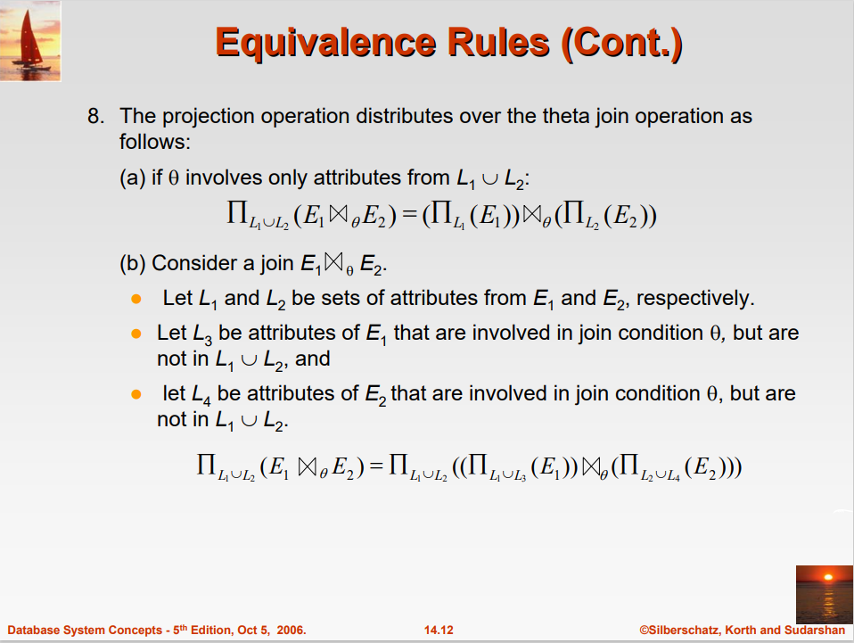
Slide 15- <number>

Slide 6
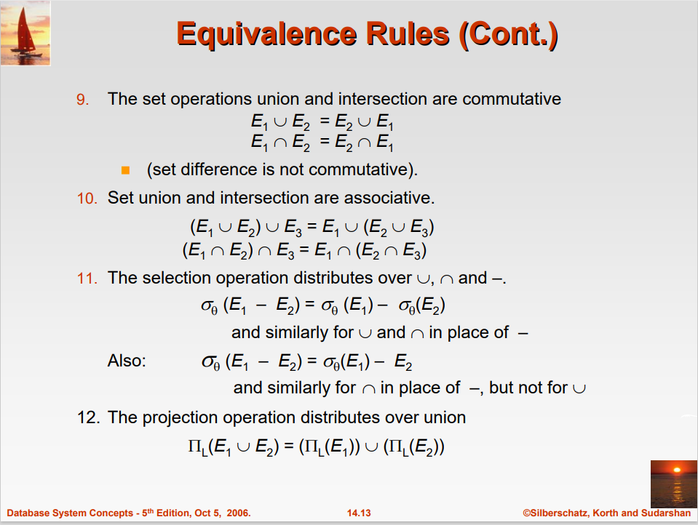
Slide 15- <number>

Slide 7
7. Using Heuristics in Query Optimization(1)
Process for heuristics optimization
  The parser of a high-level query generates an initial internal representation;
  Apply heuristics rules to optimize the internal representation.
  A query execution plan is generated to execute groups of operations based on the access paths available on the files involved in the query.
The main heuristic is to apply first the operations that reduce the size of intermediate results.
  E.g., Apply SELECT and PROJECT operations before applying the JOIN or other binary operations.
Slide 15- <number>

Slide 8
Using Heuristics in Query Optimization (2)
Query tree:
  A tree data structure that corresponds to a relational algebra expression. It represents the input relations of the query as leaf nodes of the tree, and represents the relational algebra operations as internal nodes.
An execution of the query tree consists of executing an internal node operation whenever its operands are available and then replacing that internal node by the relation that results from executing the operation.
Query graph:
  A graph data structure that corresponds to a relational calculus expression. It does not indicate an order on which operations to perform first. There is only a single graph corresponding to each query.
Slide 15- <number>

Slide 9
Using Heuristics in Query Optimization (3)
Example:
  For every project located in ‘Stafford’, retrieve the project number, the controlling department number and the department manager’s last name, address and birthdate.
Relation algebra:
  πPNUMBER, DNUM, LNAME, ADDRESS, BDATE (((σ_{PLOCATION=‘STAFFORD’}(PROJECT))
  _{DNUM=DNUMBER} (DEPARTMENT)) _{MGRSSN=SSN} (EMPLOYEE))
SQL query:
  Q2: SELECT P.NUMBER,P.DNUM,E.LNAME,
  E.ADDRESS, E.BDATE
  FROM PROJECT AS P,DEPARTMENT AS D, EMPLOYEE AS E
  WHERE P.DNUM=D.DNUMBER AND D.MGRSSN=E.SSN AND P.PLOCATION=‘STAFFORD’;
Slide 15- <number>

Slide 10
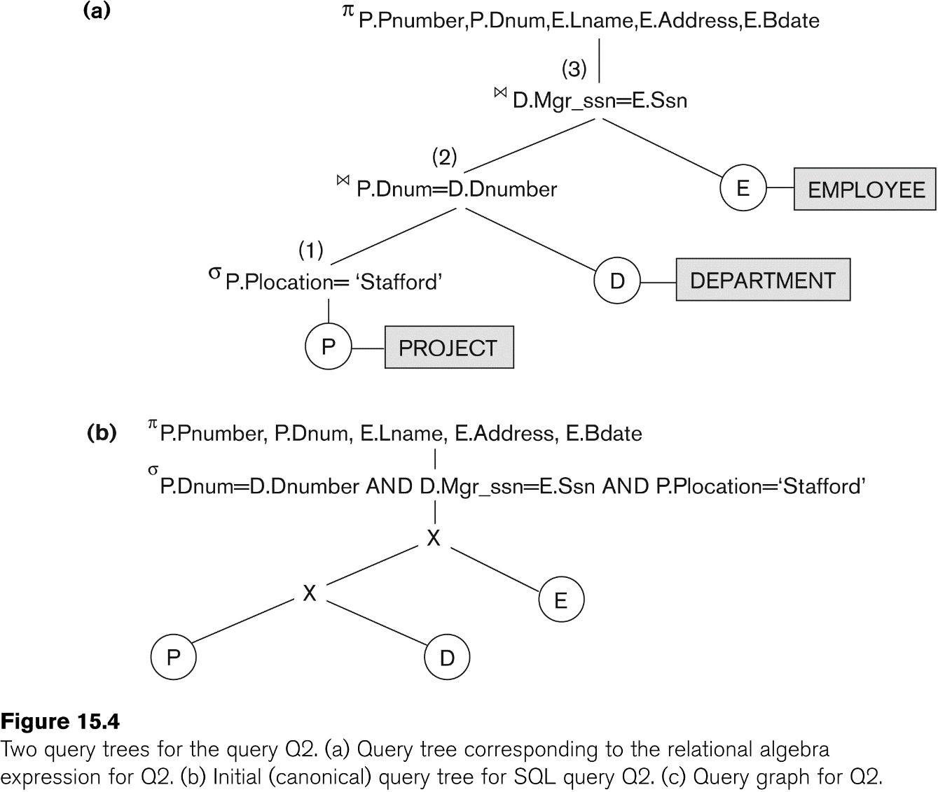
Using Heuristics in Query Optimization (4)
Slide 15- <number>

Slide 11
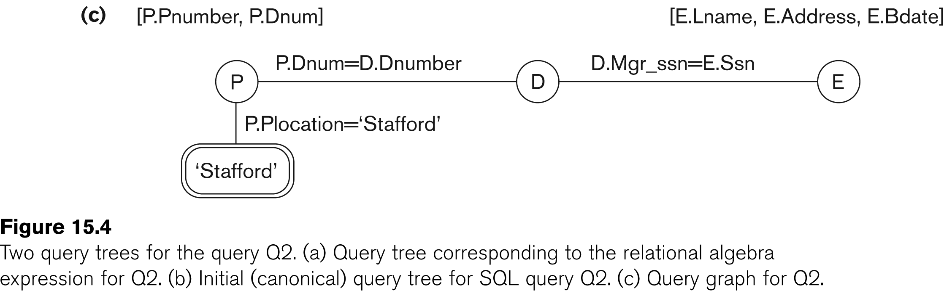
Using Heuristics in Query Optimization (5)
Slide 15- <number>

Slide 12
Using Heuristics in Query Optimization (6)
Heuristic Optimization of Query Trees:
  The same query could correspond to many different relational algebra expressions — and hence many different query trees.
  The task of heuristic optimization of query trees is to find a final query tree that is efficient to execute.
Example:
  Q: SELECT LNAME
  FROM EMPLOYEE, WORKS_ON, PROJECT
  WHERE PNAME = ‘AQUARIUS’ AND PNMUBER=PNO AND ESSN=SSN AND BDATE > ‘1957-12-31’;
Slide 15- <number>

Slide 13
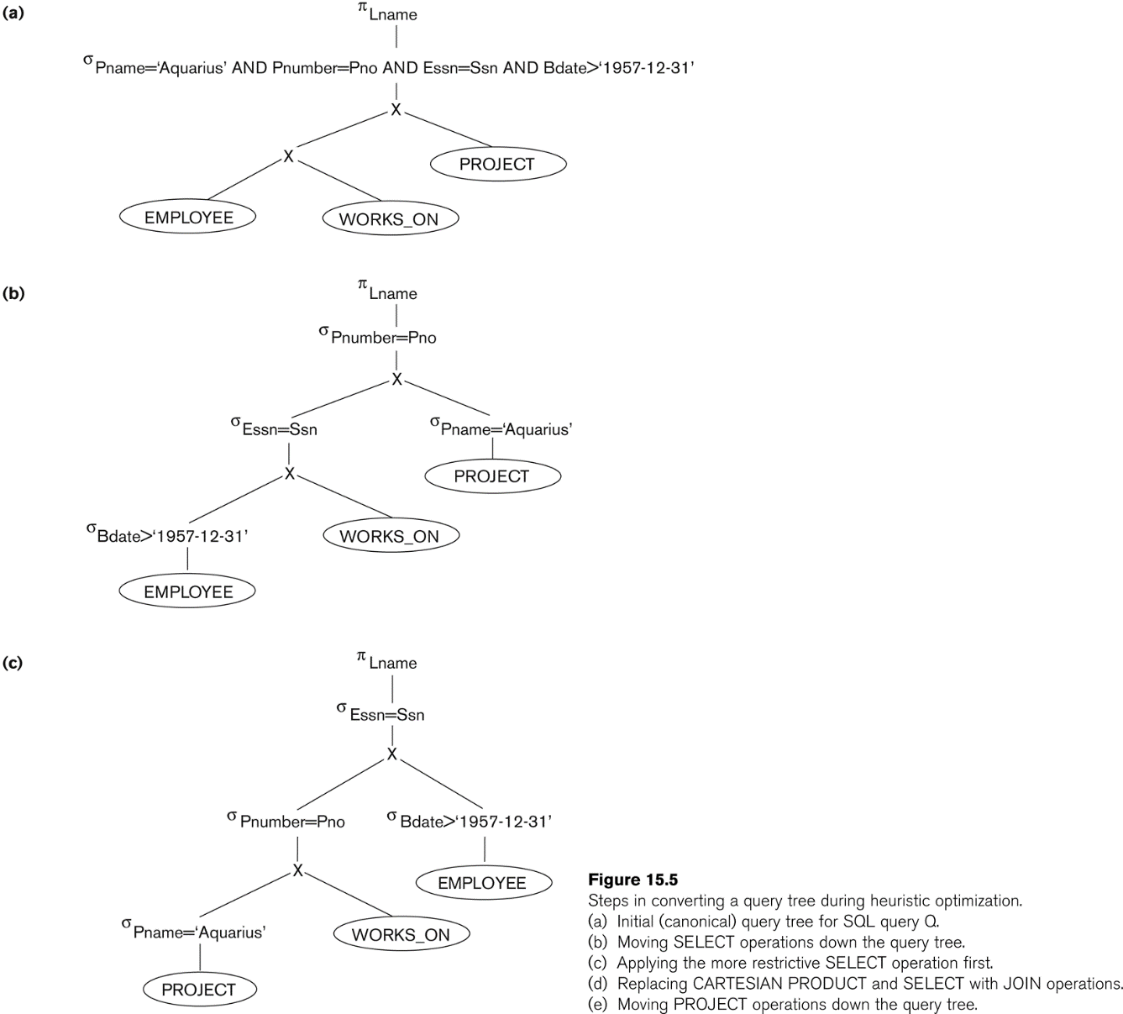
Using Heuristics in Query Optimization (7)
Slide 15- <number>

Slide 14
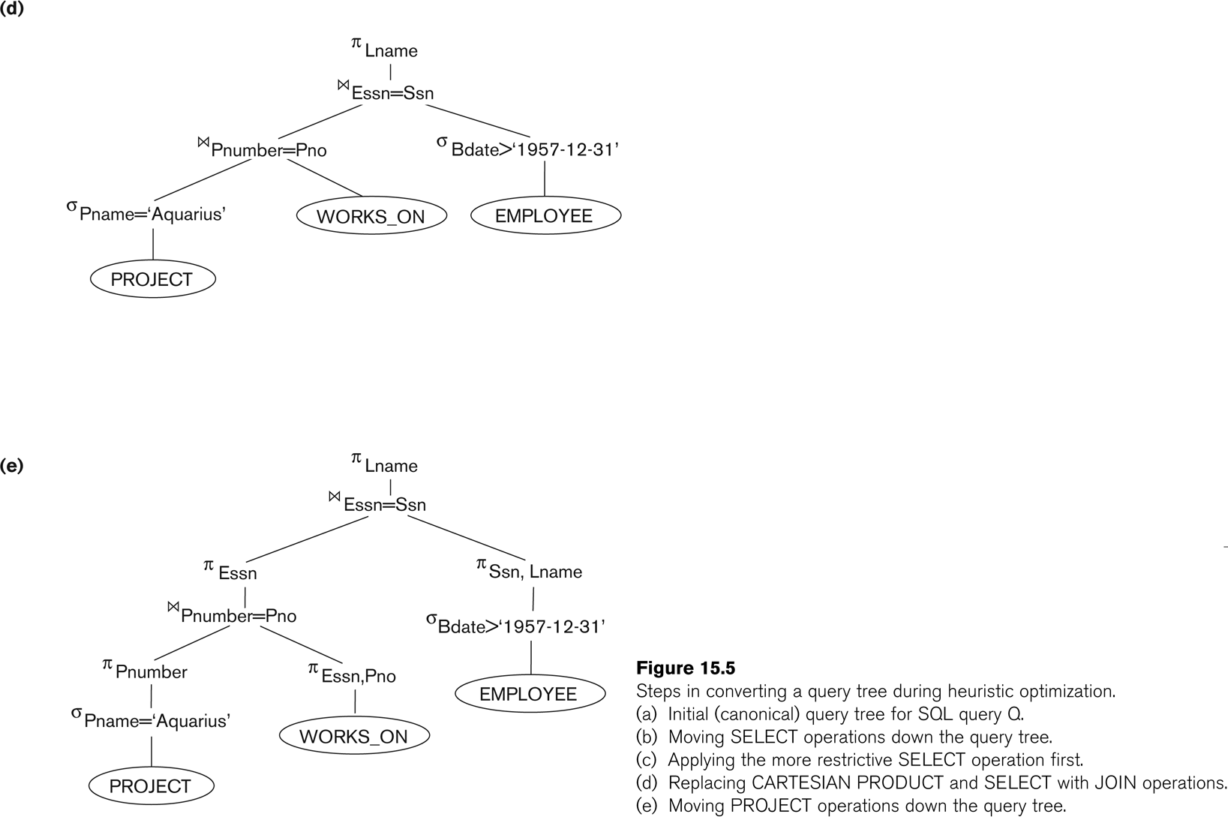
Using Heuristics in Query Optimization (8)
Slide 15- <number>

Slide 15
Using Heuristics in Query Optimization (9)
General Transformation Rules for Relational Algebra Operations:
1. Cascade of σ: A conjunctive selection condition can be broken up into a cascade (sequence) of individual σ operations:
  σ _{c1 AND c2 AND ... AND cn}(R) = σ_{c1} (σ_{c2} (...(σ_{cn}(R))...) )
2. Commutativity of σ: The σ operation is commutative:
  σ_{c1} (σ_{c2}(R)) = σ_{c2} (σ_{c1}(R))
3. Cascade of π: In a cascade (sequence) of π operations, all but the last one can be ignored:
  π_{List1} (π_{List2} (...(π_{Listn}(R))...) ) = π_{List1}(R)
4. Commuting σ with π: If the selection condition c involves only the attributes A1, ..., An in the projection list, the two operations can be commuted:
  π_{A1, A2, ..., An} (σ_{c} (R)) = σ_{c} (π_{A1, A2, ..., An} (R))
Slide 15- <number>

Slide 16
Using Heuristics in Query Optimization (10)
General Transformation Rules for Relational Algebra Operations (contd.):
5. Commutativity of ( and x ): The operation is commutative as is the x operation:
  R _{C} S = S _{C} R; R x S = S x R
6. Commuting σ with (or x ): If all the attributes in the selection condition c involve only the attributes of one of the relations being joined—say, R—the two operations can be commuted as follows:
  σ_{c} ( R S ) = (σ_{c} (R)) S
Alternatively, if the selection condition c can be written as (c1 and c2), where condition c1 involves only the attributes of R and condition c2 involves only the attributes of S, the operations commute as follows:
  σ_{c} ( R S ) = (σ_{c1} (R)) (σ_{c2} (S))
Slide 15- <number>

Slide 17
Using Heuristics in Query Optimization (11)
General Transformation Rules for Relational Algebra Operations (contd.):
7. Commuting π with (or x): Suppose that the projection list is L = {A1, ..., An, B1, ..., Bm}, where A1, ..., An are attributes of R and B1, ..., Bm are attributes of S. If the join condition c involves only attributes in L, the two operations can be commuted as follows:
  π_{L} ( R _{C} S ) = (π_{A1, ..., An} (R)) _{C} (π _{B1, ..., Bm} (S))
If the join condition C contains additional attributes not in L, these must be added to the projection list, and a final π operation is needed.
Slide 15- <number>

Slide 18
Using Heuristics in Query Optimization (12)
General Transformation Rules for Relational Algebra Operations (contd.):
8. Commutativity of set operations: The set operations υ and ∩ are commutative but “–” is not.
9. Associativity of , x, υ, and ∩ : These four operations are individually associative; that is, if θ stands for any one of these four operations (throughout the expression), we have
  ( R θ S ) θ T = R θ ( S θ T )
10. Commuting σ with set operations: The σ operation commutes with υ , ∩ , and –. If θ stands for any one of these three operations, we have
  σ_{c} ( R θ S ) = (σ_{c} (R)) θ (σ_{c} (S))
Slide 15- <number>

Slide 19
Using Heuristics in Query Optimization (13)
General Transformation Rules for Relational Algebra Operations (contd.):
The π operation commutes with υ. π_{L} ( R υ S ) = (π_{L} (R)) υ (π_{L} (S))
Converting a (σ, x) sequence into : If the condition c of a σ that follows a x Corresponds to a join condition, convert the (σ, x) sequence into a as follows: (σ_{C} (R x S)) = (R _{C} S)
Other transformations
Slide 15- <number>

Slide 20
Using Heuristics in Query Optimization (14)
Outline of a Heuristic Algebraic Optimization Algorithm:
Using rule 1, break up any select operations with conjunctive conditions into a cascade of select operations.
Using rules 2, 4, 6, and 10 concerning the commutativity of select with other operations, move each select operation as far down the query tree as is permitted by the attributes involved in the select condition.
Using rule 9 concerning associativity of binary operations, rearrange the leaf nodes of the tree so that the leaf node relations with the most restrictive select operations are executed first in the query tree representation.
Using Rule 12, combine a Cartesian product operation with a subsequent select operation in the tree into a join operation.
Using rules 3, 4, 7, and 11 concerning the cascading of project and the commuting of project with other operations, break down and move lists of projection attributes down the tree as far as possible by creating new project operations as needed.
Identify subtrees that represent groups of operations that can be executed by a single algorithm.
Slide 15- <number>

Slide 21
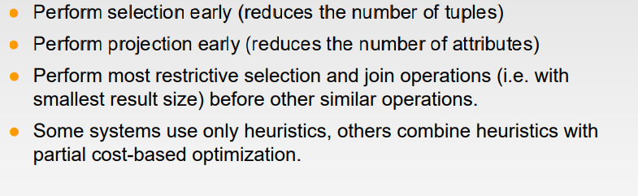
Slide 15- <number>

Slide 22
Using Heuristics in Query Optimization (15)
Summary of Heuristics for Algebraic Optimization:
  The main heuristic is to apply first the operations that reduce the size of intermediate results.
  Perform select operations as early as possible to reduce the number of tuples and perform project operations as early as possible to reduce the number of attributes. (This is done by moving select and project operations as far down the tree as possible.)
  The select and join operations that are most restrictive should be executed before other similar operations. (This is done by reordering the leaf nodes of the tree among themselves and adjusting the rest of the tree appropriately.)
Slide 15- <number>

Slide 23
Using Heuristics in Query Optimization (16)
Query Execution Plans
  An execution plan for a relational algebra query consists of a combination of the relational algebra query tree and information about the access methods to be used for each relation as well as the methods to be used in computing the relational operators stored in the tree.
  Materialized evaluation: the result of an operation is stored as a temporary relation.
  Pipelined evaluation: as the result of an operator is produced, it is forwarded to the next operator in sequence.
Slide 15- <number>

Slide 24
8. Using Selectivity and Cost Estimates in Query Optimization (1)
Cost-based query optimization:
  Estimate and compare the costs of executing a query using different execution strategies and choose the strategy with the lowest cost estimate.
  (Compare to heuristic query optimization)
Issues
  Cost function
  Number of execution strategies to be considered
Slide 15- <number>

Slide 25
Using Selectivity and Cost Estimates in Query Optimization (2)
Cost Components for Query Execution
  Access cost to secondary storage
  Storage cost(store intermediate files)
  Computation cost
  Memory usage cost-no of memory buffer at time of execution
  Communication cost
Note: Different database systems may focus on different cost components.
Slide 15- <number>

Slide 26
Using Selectivity and Cost Estimates in Query Optimization (3)
Catalog Information Used in Cost Functions
  Information about the size of a file
    number of records (tuples) (r),
    record size (R),
    number of blocks (b)
    blocking factor (bfr) –records/block
  Information about indexes and indexing attributes of a file
    Number of levels (x) of each multilevel index
    Number of first-level index blocks (bI1)
    Number of distinct values (d) of an attribute
    Selectivity (sl) of an attribute-fraction of records
    Selection cardinality (s) of an attribute. (s = sl * r)-no of records
Slide 15- <number>

Slide 27
Using Selectivity and Cost Estimates in Query Optimization (4)
Examples of Cost Functions for SELECT
S1. Linear search (brute force) approach
  C_{S1a} = b;
  For an equality condition on a key, C_{S1a} = (b/2) if the record is found; otherwise C_{S1a} = b.
S2. Binary search:
  C_{S2} = log₂b + (s/bfr)⎤ –1
  For an equality condition on a unique (key) attribute, C_{S2} =log₂b
S3. Using a primary index (S3a) or hash key (S3b) to retrieve a single record
  C_{S3a} = x + 1; C_{S3b} = 1 for static or linear hashing;
  C_{S3b} = 1 for extendible hashing;
Slide 15- <number>

Slide 28
Using Selectivity and Cost Estimates in Query Optimization (5)
Examples of Cost Functions for SELECT (contd.)
S4. Using an ordering index to retrieve multiple records:
  For the comparison condition on a key field with an ordering index, C_{S4} = x + (b/2)
S5. Using a clustering index to retrieve multiple records:
  C_{S5} = x + ┌ (s/bfr) ┐
S6. Using a secondary (B+-tree) index:
  For an equality comparison, C_{S6a} = x + s;
  For an comparison condition such as >, <, >=, or <=,
  C_{S6a} = x + (b_{I1}/2) + (r/2)
Slide 15- <number>

Slide 29
Using Selectivity and Cost Estimates in Query Optimization (6)
Examples of Cost Functions for SELECT (contd.)
S7. Conjunctive selection:
  Use either S1 or one of the methods S2 to S6 to solve.
  For the latter case, use one condition to retrieve the records and then check in the memory buffer whether each retrieved record satisfies the remaining conditions in the conjunction.
S8. Conjunctive selection using a composite index:
  Same as S3a, S5 or S6a, depending on the type of index.
Examples of using the cost functions.
Slide 15- <number>

Slide 30
Using Selectivity and Cost Estimates in Query Optimization (7)
Examples of Cost Functions for JOIN
  Join selectivity (js)
  js = | (R _{C} S) | / | R x S | = | (R _{C} S) | / (|R| * |S |)
    If condition C does not exist, js = 1;
    If no tuples from the relations satisfy condition C, js = 0;
    Usually, 0 <= js <= 1;
Size of the result file after join operation
  | (R _{C} S) | = js * |R| * |S |
Slide 15- <number>

Slide 31
Using Selectivity and Cost Estimates in Query Optimization (8)
Examples of Cost Functions for JOIN (contd.)
J1. Nested-loop join:
  C_{J1} = b_{R} + (b_{R}*b_{S}) + ((js* |R|* |S|)/bfr_{RS})
  (Use R for outer loop)
J2. Single-loop join (using an access structure to retrieve the matching record(s))
  If an index exists for the join attribute B of S with index levels x_{B}, we can retrieve each record s in R and then use the index to retrieve all the matching records t from S that satisfy t[B] = s[A].
  The cost depends on the type of index.
Slide 15- <number>

Slide 32
Using Selectivity and Cost Estimates in Query Optimization (9)
Examples of Cost Functions for JOIN (contd.)
J2. Single-loop join (contd.)
  For a secondary index,
    C_{J2a} = b_{R} + (|R| * (x_{B} + s_{B})) + ((js* |R|* |S|)/bfr_{RS});
  For a clustering index,
    C_{J2b} = b_{R} + (|R| * (x_{B} + (s_{B}/bfr_{B}))) + ((js* |R|* |S|)/bfr_{RS});
  For a primary index,
    C_{J2c} = b_{R} + (|R| * (x_{B} + 1)) + ((js* |R|* |S|)/bfr_{RS});
  If a hash key exists for one of the two join attributes — B of S
    C_{J2d} = b_{R} + (|R| * h) + ((js* |R|* |S|)/bfr_{RS});
J3. Sort-merge join:
    C_{J3a} = C_{S} + b_{R} + b_{S} + ((js* |R|* |S|)/bfr_{RS});
    (CS: Cost for sorting files)
Slide 15- <number>

Slide 33
Using Selectivity and Cost Estimates in Query Optimization (10)
Multiple Relation Queries and Join Ordering
  A query joining n relations will have n-1 join operations, and hence can have a large number of different join orders when we apply the algebraic transformation rules.
  Current query optimizers typically limit the structure of a (join) query tree to that of left-deep (or right-deep) trees.
Left-deep tree:
  A binary tree where the right child of each non-leaf node is always a base relation.
    Amenable to pipelining
    Could utilize any access paths on the base relation (the right child) when executing the join.
Slide 15- <number>

Slide 34
9. Overview of Query Optimization in Oracle
Oracle DBMS V8
  Rule-based query optimization: the optimizer chooses execution plans based on heuristically ranked operations.
    (Currently it is being phased out)
  Cost-based query optimization: the optimizer examines alternative access paths and operator algorithms and chooses the execution plan with lowest estimate cost.
    The query cost is calculated based on the estimated usage of resources such as I/O, CPU and memory needed.
  Application developers could specify hints to the ORACLE query optimizer.
  The idea is that an application developer might know more information about the data.
Slide 15- <number>

Slide 35
10. Semantic Query Optimization
Semantic Query Optimization:
  Uses constraints specified on the database schema in order to modify one query into another query that is more efficient to execute.
Consider the following SQL query,
SELECT E.LNAME, M.LNAME
FROM EMPLOYEE E M
WHERE E.SUPERSSN=M.SSN AND E.SALARY>M.SALARY
Explanation:
  Suppose that we had a constraint on the database schema that stated that no employee can earn more than his or her direct supervisor. If the semantic query optimizer checks for the existence of this constraint, it need not execute the query at all because it knows that the result of the query will be empty. Techniques known as theorem proving can be used for this purpose.
Slide 15- <number>

Slide 36
Summary
0. Introduction to Query Processing
1. Translating SQL Queries into Relational Algebra
2. Algorithms for External Sorting
3. Algorithms for SELECT and JOIN Operations
4. Algorithms for PROJECT and SET Operations
5. Implementing Aggregate Operations and Outer Joins
6. Combining Operations using Pipelining
7. Using Heuristics in Query Optimization
8. Using Selectivity and Cost Estimates in Query Optimization
9. Overview of Query Optimization in Oracle
10. Semantic Query Optimization
Slide 15- <number>

